Slide 1

Battle of the Neighborhoods of Toronto
By Minh chau

Slide 2
Business proposal
Opening a Vietnamese restaurant in Toronto to add to the variety and diversity of Toronto
The problems to tackle is to explore the venues of Toronto neighborhoods and in turn, narrow down the ideal location for opening a Vietnamese restaurant.

Slide 3
The Data
Foursquare location data: exploring the venues in the neighborhoods of Toronto
Ethnicity data from Canadapopulation.org: examining the diversity of Toronto
Assisting libraries in Python: pandas, folium, matblotlib, numpy, JSON and Scikit Learn

Slide 4
Methodology
The first step is to cluster the neighborhoods together based on their location using Kmeans
The second step is to explore their venues (i.e finding the top-10 most common venues) based on Foursquare location data.
Ideal locations include aspects such as their locations, how familiar the neighborhood is to Asian cuisine, sourcing for ingredients, etc.

Slide 5
Analysis
Using Kmeans imported from Scikit Learn, the neighborhoods of Toronto are segmented into 5 clusters.

Slide 6
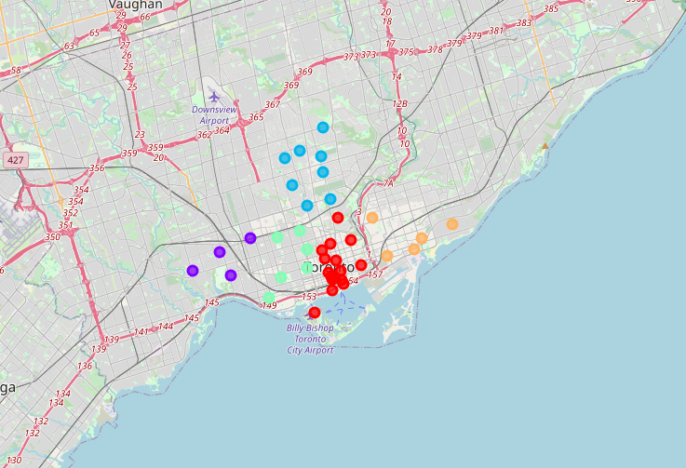

Slide 7
Analysis (Cont.)
First area is Downtown Toronto
All of these neighborhoods are good places to start a Vietnamese restaurant, especially in St. James Town if the owner wants to find some familiar cuisine because they have Japanese restaurant as second most venues

Slide 8
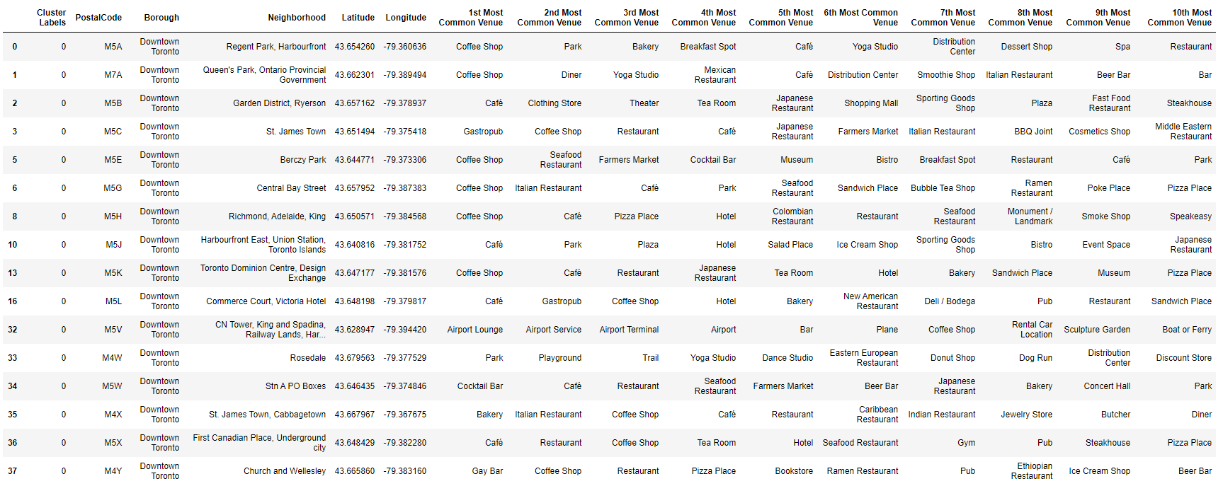

Slide 9
Analysis (Cont.)
Second area is West Toronto
The neighborhood of High Park and the Junction South could be a good spot with Thai restaurant as the most 3rd common venue.
Thai cuisine and Vietnamese cuisines share some similarities so people in this neighborhoods would be more likely to try Vietnamese food

Slide 10
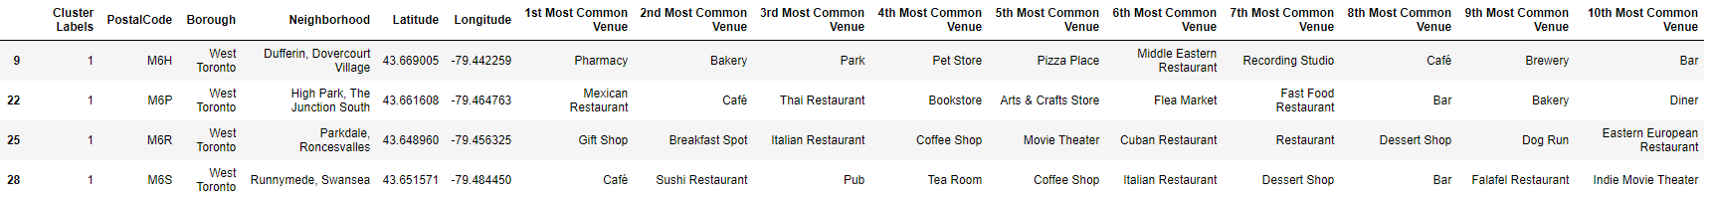

Slide 11
Analysis (Cont.)
The third area is Central Toronto
This area is suitable for quick bites and healthy food.
If the main goal is to opening a restaurant with carry-out/delivery only then any of the neighborhoods in this area would suffice

Slide 12
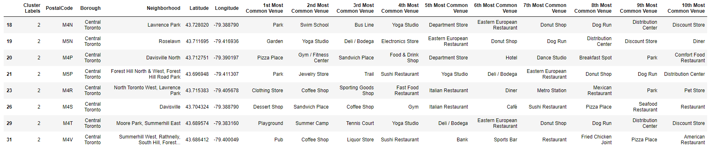

Slide 13
Analysis (Cont.)
The fourth area is the area shared between Downtown and West Toronto
Neighborhoods such as Little Portugal, Trinity, Kensington Market, Chinatown and Grange Park have Vietnamese restaurants as their 2nd most common venue
This area is a good place to open a Vietnamese restaurant

Slide 14
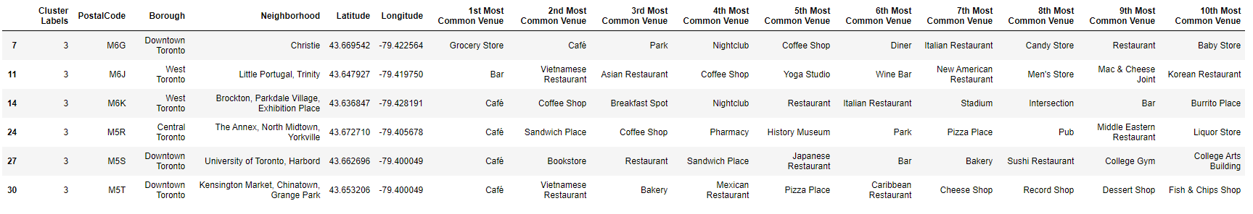

Slide 15
Analysis (Cont.)
The final area is East Toronto
This area has more stores and quick bites style restaurants
I would not recommend this neighborhoods since there seems to be no common ground for Vietnamese cuisines

Slide 16
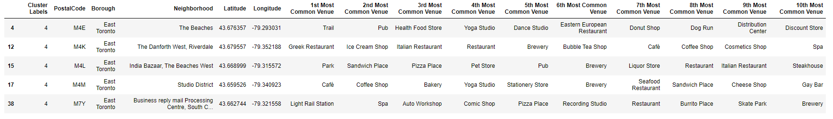

Slide 17
Analysis (Cont.)
The ethnicity percentages of the population in Toronto is included in the next table
Toronto is a very diverse city
Opening a Vietnamese restaurant would add to the variety and uniqueness of Toronto

Slide 18
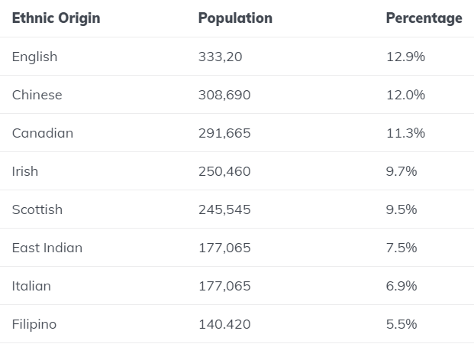

Slide 19
Results and Discussion
The neighborhoods I would recommend are:
St. James Town in Downtown Toronto
Kensington Market, Chinatown and Grange Park also near Downtown Toronto
These neighborhoods have the population already familiar with Asian cuisines, as well as they have sources for ingredients and equipment needed for a Vietnamese restaurant

Slide 20
Conclusion
The neighborhoods listed in the Result section are only suggestions
Stakeholders might need to review some more about these choices, especially which type of restaurant they want to open (dine-in, carry-out/delivery only, etc.)
There are also other factors to be included in such as prices, social and economic dynamics in these neighborhoods.

